Slide 1
Proposal of the future of Maple Story
Kim Seokjin

Slide 2
Chapter 1.
Improved hunting maps

Slide 3
Chapter 1. Improved hunting maps
Improvement direction 1
Intense competition due to more users
90%
Actually used hunting maps
10%
Unless hunting maps

Slide 4


Chapter 2. Not very fun
Jumps + live leaderboards
Rollercoaster
Install various jumps in the village
– Long jump, high jump etc.
– Real-time TOPS display
Install rollercoaster in 1 or 2 villages
Board/get off at any time

Slide 5

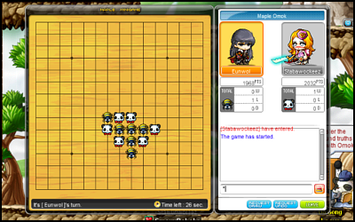
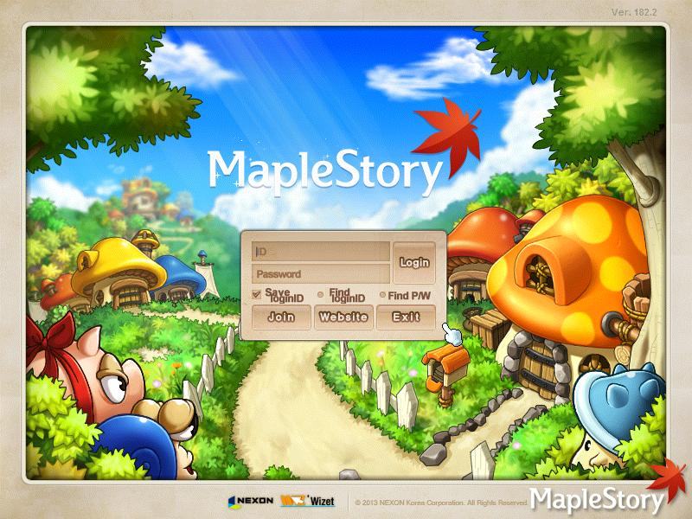

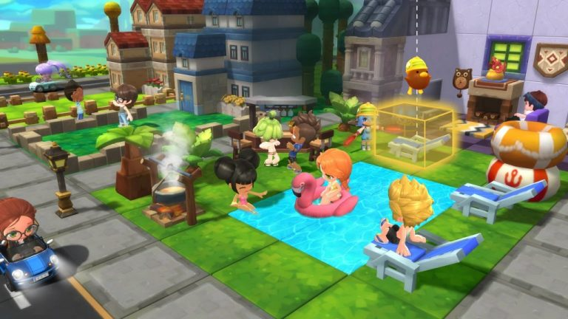
New content
1
Diverse mini games
Create multiple minigames during an event
Current
Proposed
One game, lots of EXP
Different games, moderate EXP

Slide 6


New content
2
Fresh events
Creating fresh events that can give fun to users
ROCK PAPER SCISSORS
SONGPEYON FALLING
FROM THE SKY
WORLDWIDE HANDSOME
Maple Hero coin given to the player who picks up the most sudden drop of Songpyeon
Collect “WORLDWIDE HANDSOME” letters and receive a random gift
Win 100 million Meso

